Slide 1

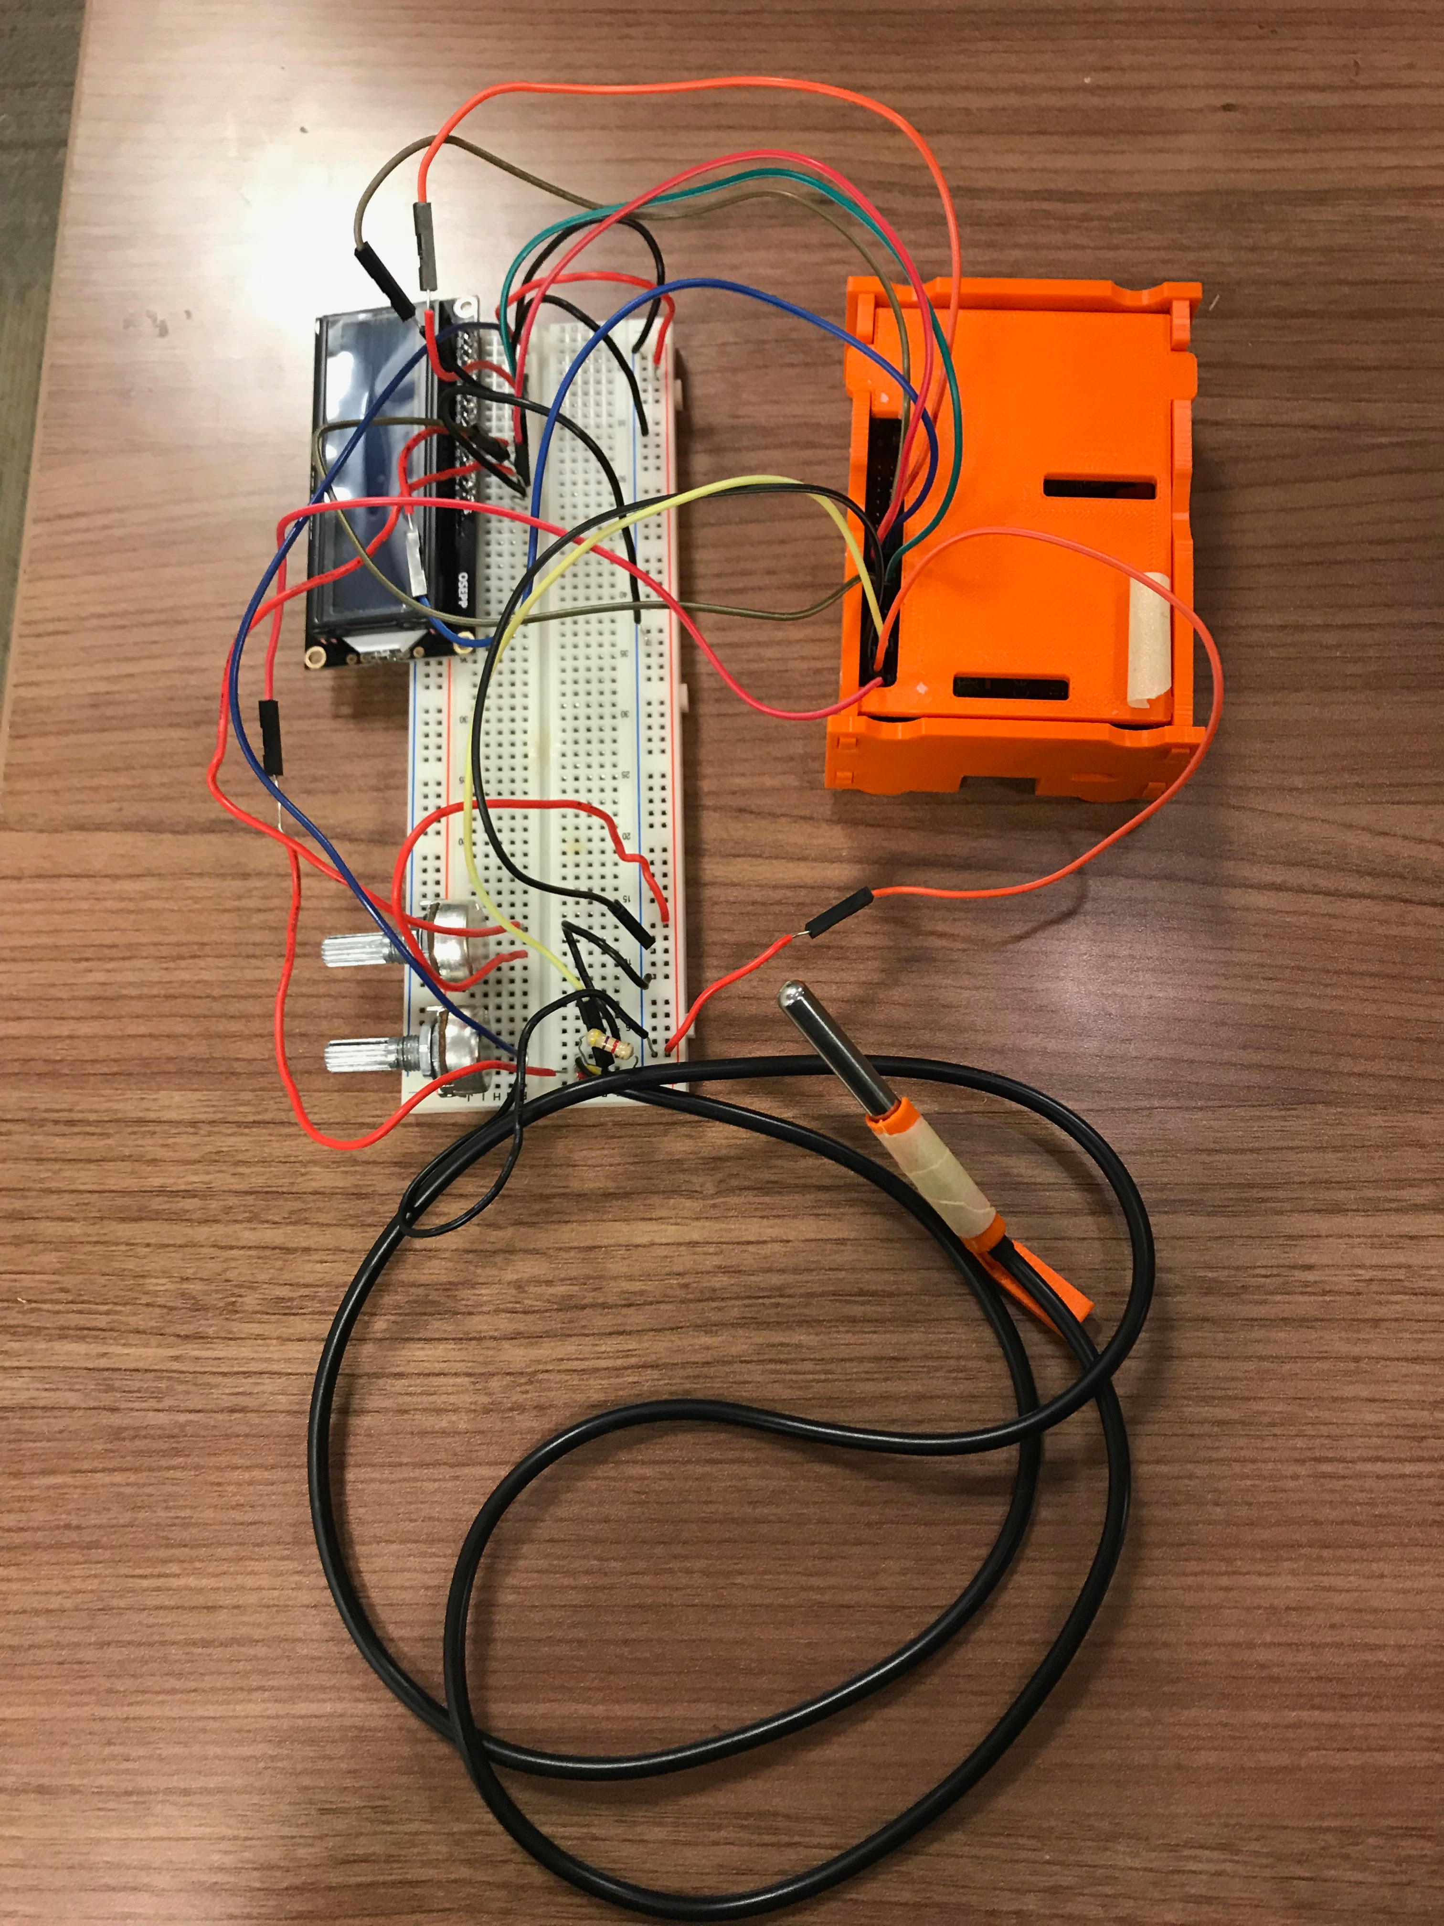
Temperature Sensor CENG 317 Gaganpreet Singh Grewal

Slide 2
Temperature Sensor INTRODUCTION:
I Chose Temperature Sensor as my Project because it has large number of applications and high user base.
Temperature is one thing that affects us all. We all care about temperature. When we want to go outside somewhere we usually check what’s the temperature outside.
My temperature sensor will sense the temperature of the surroundings and help’s our user to plan his/her visit according to the temperature at that place.

Slide 3
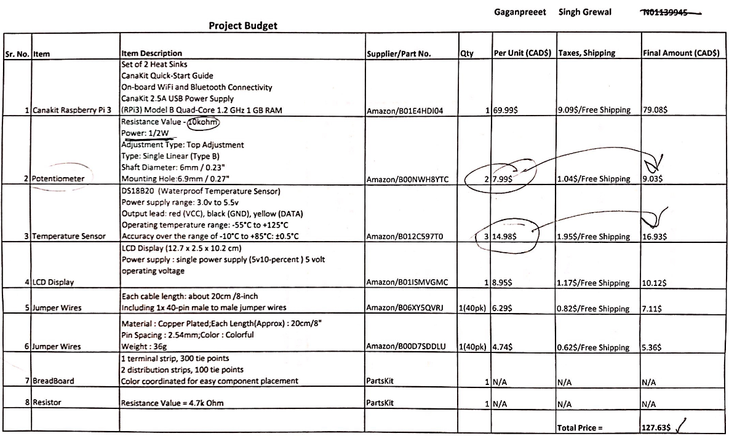
Temperature Sensor Budget:

Slide 4
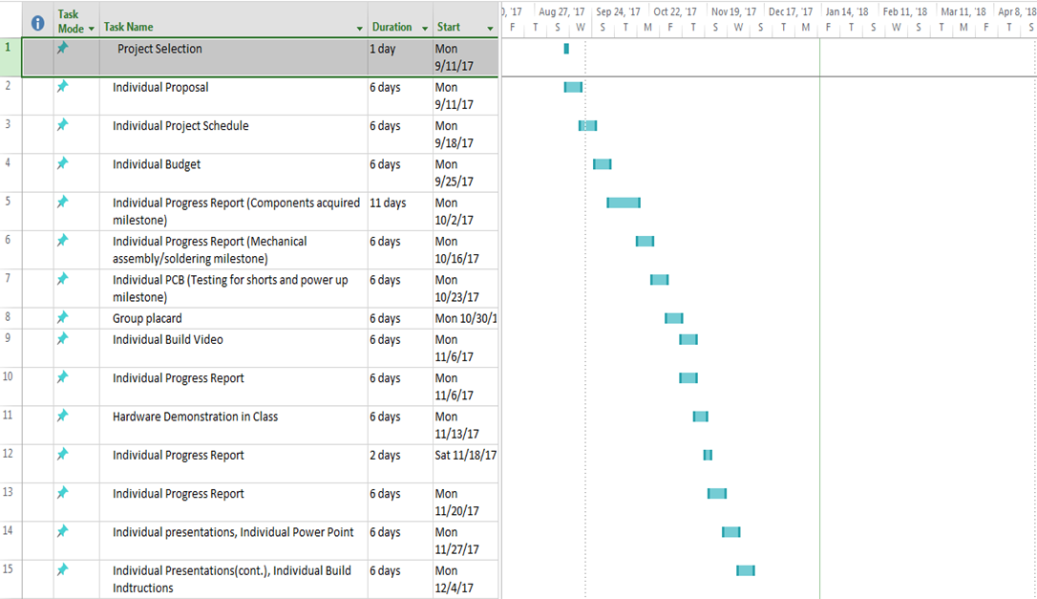
Temperature Sensor Schedule:

Slide 5

Temperature Sensor Build Video:

Slide 6
Temperature Sensor Knowledge Used from Previous Courses:
TECH 153 – In this course were introduced to the Broadcom development platform that is raspberry pi.
CENG 252 – Learned about microcomputers.
CENG 216 – Learned how to build Gantt charts.

Slide 7
Temperature Sensor
******Thank you******

